Slide 1
CRYPTOGRAPHY
Cryptography is the process of making and using codes to secure the transmission of information.
The art and science of concealing the messages to introduce secrecy in information security is recognized as cryptography.
The word ‘cryptography’ was coined by combining two Greek words, ‘Krypto’ meaning hidden and ‘graphene’ meaning writing.
Cryptanalysis is the process of obtaining the plaintext message from a ciphertext message without knowing the keys used to perform the encryption.
Cryptology is the science of encryption, which encompasses cryptography and cryptanalysis.

Slide 2
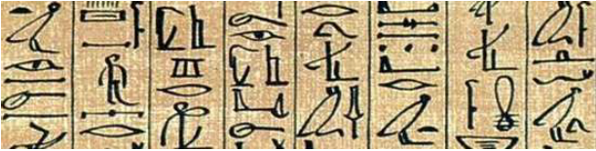
History of Cryptography
The roots of cryptography are found in Roman and Egyptian civilizations.
The art of cryptography is considered to be born along with the art of writing
need of people to communicate secretly with selective recipient in turn ensured the continuous evolution of cryptography
Hieroglyph – The Oldest Cryptographic Technique
Some 4000 years ago, the Egyptians used to communicate by messages written in hieroglyph.
This code was the secret known only to the scribes who used to transmit messages on behalf of the kings.
Notes:
Hieroglyph – a stylized picture of an object representing a word, syllable, or sound, as found in ancient Egyptian and certain other writing systems.

Slide 3
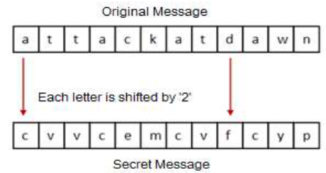
Later, the scholars moved on to using simple mono-alphabetic substitution ciphers during 500 to 600 BC.
This involved replacing alphabets of message with other alphabets with some secret rule.
This rule became a key to retrieve the message back from the garbled message.
Caesar Shift Cipher
The earlier Roman method of cryptography
Involve shifting the letters of a message by an agreed number
the recipient of this message would then shift the letters back by the same number and obtain the original message

Slide 4
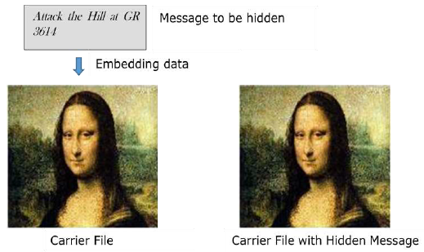
Steganography
Here people not only want to protect the secrecy of an information by concealing it, but they also want to make sure any unauthorized person gets no evidence that the information even exists. E.g. invisible watermarking.
In steganography, an unintended recipient or an intruder is unaware of the fact that observed data contains hidden information. In cryptography, an intruder is normally aware that data is being communicated, because they can see the coded/scrambled message.
Notes:
invisible watermarking

Slide 5
Evolution of Cryptography
15th century, Improved coding techniques e.g Vigenere Coding
offered moving letters in the message with a number of variable places instead of moving them the same number of places
After the 19th century, cryptography evolved from the ad hoc approaches to encryption to the more sophisticated art and science of information security
In the early 20th century, the invention of mechanical and electromechanical machines, such as the Enigma rotor machine, provided more advanced and efficient means of coding the information.
During the period of World War II, both cryptography and cryptanalysis became excessively mathematical.
Government, organizations, military units, and some corporate houses started adopting the applications of cryptography
They used cryptography to guard their secrets from others
Notes:
Information only

Slide 6
Modern Cryptography
Its foundation is based on various concepts of mathematics such as number theory, computational-complexity theory, and probability theory.
Classic Cryptography | Modern Cryptography
It manipulates traditional characters, i.e., letters and digits directly | It operates on binary bit sequences
It is mainly based on ‘security through obscurity’. The techniques employed for coding were kept secret and only the parties involved in communication knew about them | It relies on publicly known mathematical algorithms for coding the information. Secrecy is obtained through a secret key which is used as the seed for the algorithms. The computational difficulty of algorithms, absence of secret key, etc., make it impossible for an attacker to obtain the original information even if he knows the algorithm used for coding
It requires the entire cryptosystem for communicating confidentially | Modern cryptography requires parties interested in secure communication to possess the secret key only
Notes:
Information only

Slide 7
Security Services of Cryptography
The objective of using cryptography is to provide the following four fundamental information security services:
Confidentiality
It is a security service that keeps the information from an unauthorized person. It is sometimes referred to as privacy or secrecy.
Data Integrity
It is security service that deals with identifying any alteration to the data.
Authentication
Authentication provides the identification of the originator. It confirms to the receiver that the data received has been sent only by an identified and verified sender.
Non-repudiation
It is a security service that ensures that an entity cannot refuse the ownership of a previous commitment or an action. It is an assurance that the original creator of the data cannot deny the creation or transmission of the said data to a recipient or third party.

Slide 8
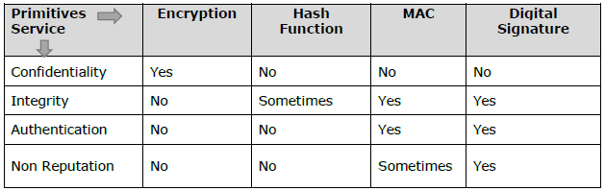
Cryptography Primitives
Cryptography primitives are nothing but the tools and techniques in Cryptography that can be selectively used to provide a set of desired security services.
Encryption
Hash functions
Message Authentication codes (MAC)
Digital Signatures
Notes:
Read more

Slide 9
Cryptographic Attacks
Attacks on cryptosystems are categorized as follows:
Ciphertext Only Attacks (COA)
In this method, the attacker has access to a set of ciphertext(s). He does not have access to corresponding plaintext. COA is said to be successful when the corresponding plaintext can be determined from a given set of ciphertext.
Known Plaintext Attack (KPA)
In this method, the attacker knows the plaintext for some parts of the ciphertext. The task is to decrypt the rest of the ciphertext using this information. E.g. linear cryptanalysis against block ciphers.
Chosen Plaintext Attack (CPA)
Here, the attacker has the text of his choice encrypted. So he has the ciphertext-plaintext pair of his choice. This simplifies his task of determining the encryption key. An example of this attack is differential cryptanalysis applied against block ciphers as well as hash functions.
Notes:
RSA (Rivest Shamir Adleman) – algorithm used by modern computers to encrypt and decrypt messages. It is an Asymmetric cryptographic algorithm. S

Slide 10
Dictionary Attack
This attack has many variants, all of which involve compiling a ‘dictionary’. In simplest method of this attack, attacker builds a dictionary of ciphertexts and corresponding plaintexts that he has learnt over a period of time. In future, when an attacker gets the ciphertext, he checks the dictionary to find the corresponding plaintext.
Birthday Attack
This attack is a variant of brute-force technique. It is used against the cryptographic hash function. When students in a class are asked about their birthdays, the answer is one of the possible 365 dates. Let us assume the first student’s birthdate is 3rd Aug. Then to find the next student whose birthdate is 3rd Aug, we need to enquire 1.25*√365 ≈ 25 students.
Similarly, if the hash function produces 64 bit hash values, the possible hash values are 1.8x10(19). By repeatedly evaluating the function for different inputs, the same output is expected to be obtained after about 5.1x10(9) random inputs.
If the attacker is able to find two different inputs that give the same hash value, it is a collision and that hash function is said to be broken.
Notes:
Read more about Birthday attack

Slide 11
Brute Force Attack (BFA)
In this method, the attacker tries to determine the key by attempting all possible keys. If the key is 8 bits long, then the number of possible keys is 2⁸ = 256. The attacker knows the ciphertext and the algorithm, now he attempts all the 256 keys one by one for decryption.
The time to complete the attack would be very high if the key is long.
Man in Middle Attack (MIM)
The targets of this attack are mostly public key cryptosystems where key exchange is involved before communication takes place.
Host A wants to communicate to host B, hence requests public key of B.
An attacker intercepts this request and sends his public key instead.
Thus, whatever host A sends to host B, the attacker is able to read.
In order to maintain communication, the attacker re-encrypts the data after reading with his public key and sends to B.
The attacker sends his public key as A’s public key so that B takes it as if it is taking it from A.

Slide 12
Side Channel Attack (SCA)
This type of attack is not against any particular type of cryptosystem or algorithm. Instead, it is launched to exploit the weakness in physical implementation of the cryptosystem.
Timing Attacks
They exploit the fact that different computations take different times to compute on processor. By measuring such timings, it is be possible to know about a particular computation the processor is carrying out. For example, If the encryption takes a longer time, it indicates that the secret key is long.
Power Analysis Attacks
These attacks are similar to timing attacks except that the amount of power consumption is used to obtain information about the nature of the underlying computations.
Fault analysis Attacks
In these attacks, errors are induced to the cryptosystem and the attacker studies the resulting output for useful information

Slide 13
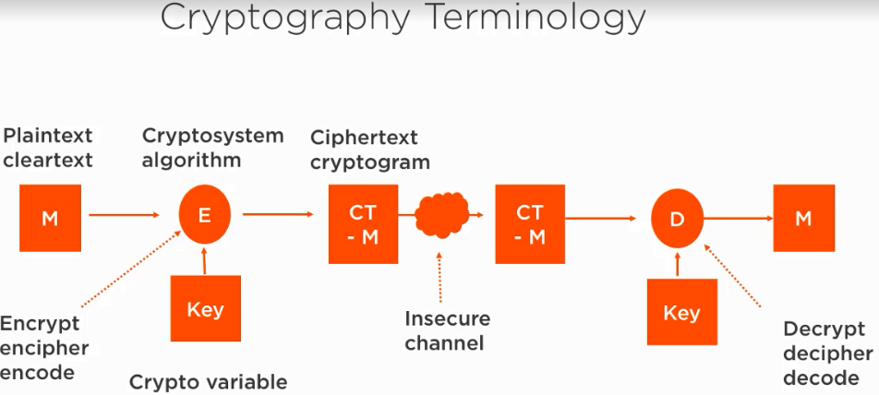

Slide 14
References
[1] Principle of Information Security by Michael E. Whitman, 5th Edition, Herbert J. Mattord.
[2] Network Security Essentials: Applications and Standards, 4th Edition, William Stallings.

